Slide 1

SpendingPulse ™ and Sector Insights™ API
A Customer and Administrator How To
R. Paul Crafts

Slide 2
Customer API How To

Slide 3
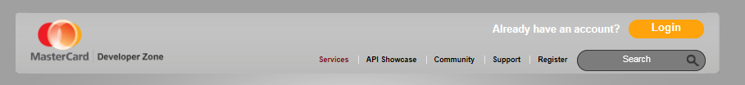
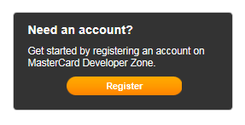
Register For API Access (1)
Customer API How To
Use this URL: https://developer.mastercard.com/portal/display/api/API
Initiate the registration process
Do this:
Or this:

Slide 4
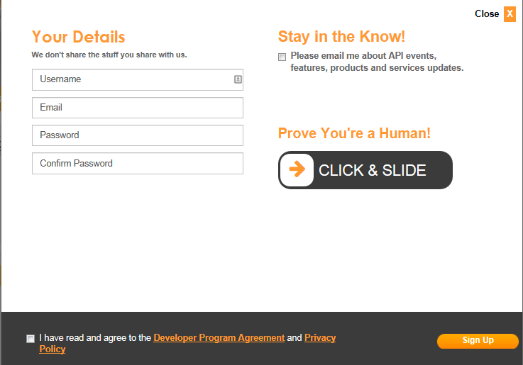
Register For API Access (2)
Customer API How To
Enter the requested “Your Details” Information.
Username can be anything you like.
Email needs to be an email address to which we can send API notifications and information (not used for marketing purposes).
Password is of your choosing – follow the on-screen rules.
To enhance the security of your access, you will be asked, from time-to-time to change your password.

Slide 5

Register For API Access (3)
Customer API How To
If you want marketing information, you may opt in by clicking the “Stay in the Know!” checkbox.
Click & Slide the “Prove You’re a Human” slider. It should now read .
Use the provided links to review the “Developer Program Agreement” and the “Privacy Policy” then click the “I have read …” checkbox.
Click the Sign Up button.

Slide 6
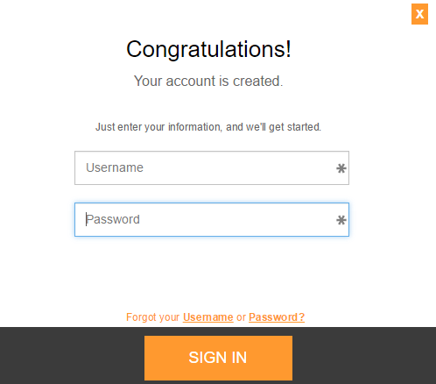
Register For API Access (4)
Customer API How To
You will receive an email for verification of you registration. To activate your account, open the email and click the link therein.
Use your new credentials to sign in.
If successful you will see the screen shown on the next slide.

Slide 7

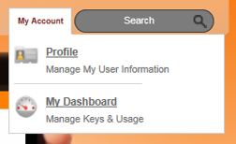
Create/Register a Key
Customer API How To
Click My Account
Then click My Dashboard

Slide 8
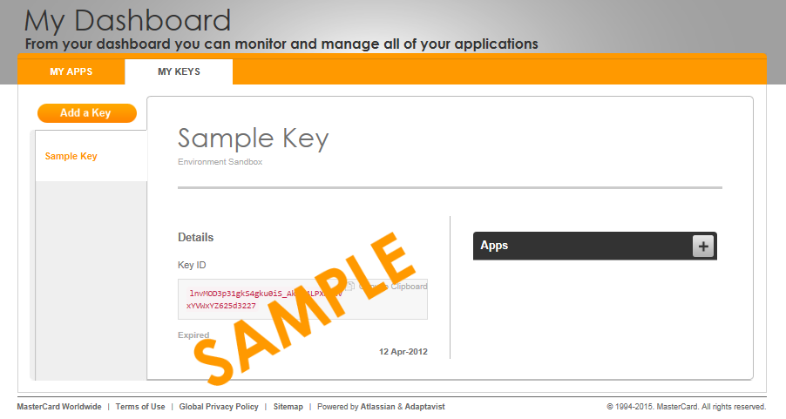
Create/Register a Key (2)
Customer API How To
In order to access the MasterCard APIs you need an approved key.
To get a key for OpenAPI you will need to upload a Certificate Signing Request (CSR). You can create the CSR on you own or by using our key tool to create the necessary files for you. This tool can be accessed by signing in to Developer Zone, and selecting:
My Dashboard (shown on previous slide)
“My Keys” then “Add a Key”

Slide 9
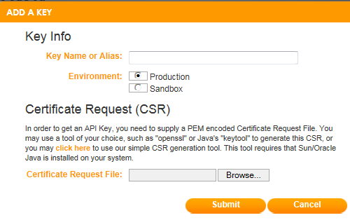
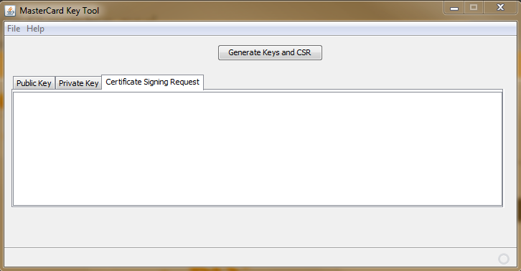
Create/Register a Key (3)
Customer API How To
Inside the next popup, you will see a “click here” notation that will open the MasterCard Key Tool for your use.
If you “click here”, the MasterCard Key Tool is displayed.
Click “Generate Keys and CSR”

Slide 10
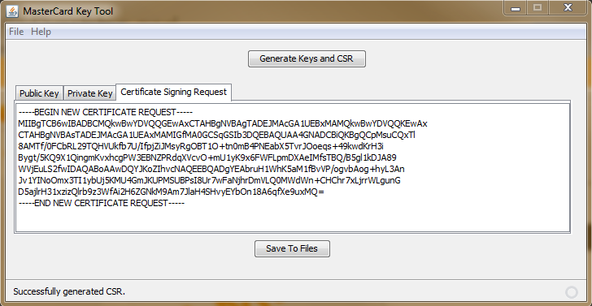
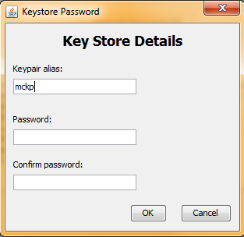

Create/Register a Key (4)
Customer API How To
A public key, a private key, and a Certificate Signing Request are generated.
Click “Save To Files”
You are prompted to password protect the key files. You must protect them in order to save them.
Click OK and choose a folder in which to save the files.
The status bar on the MasterCard Key Tool window should now read:
Close the window

Slide 11
Create/Register a Key (5)
Customer API How To
The “Add a Key” dialogue is redisplayed.
Enter a Name/Alias for this key.
This can be any alphanumeric value, and will help you identify the key, in the case that you register multiple keys.
Choose which environment the key will be used for gaining access: Production/Sandbox
You should first register a Sandbox key, then once you are ready to work with our Production environment, you will need to repeat this process to register a Production key.
Browse to and select the “.pem” file created by the MasterCard Key Tool
Click Submit … if successful … see next slide

Slide 12
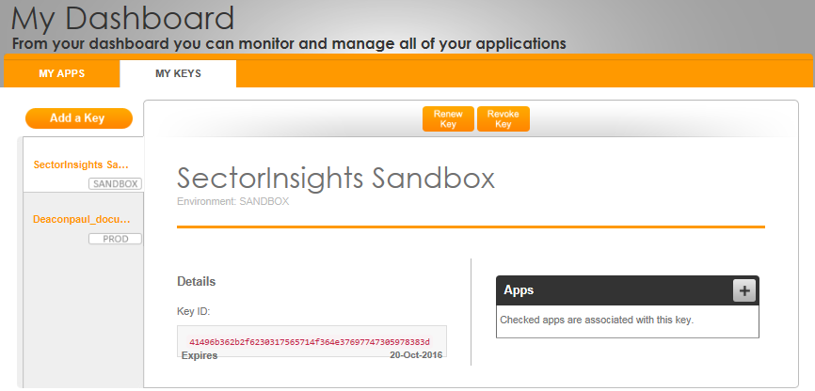

Create/Register a Key (6)
Customer API How To
Your dashboard is redisplayed with the most recent key showing.
Note: OpenAPI keys are good for one year. Approximately 30 days before your key is set to expire, we will notify you at the email address we have on file for you. For this reason it is important that you keep your email address with OpenAPI current. A few additional reminders will be sent up to the point of key expiration. Once your key has expired, any messages to the OpenAPI will be rejected.

Slide 13
Create/Register a Key (6 - continued)
Customer API How To
To avoid issues with key expiration, you may renew a key at any time. To do so, sign in to Developer Zone, and select:
My Dashboard
My Keys (locate the key you wish to renew)
Renew Key
Follow the instructions in the pop-up for uploading a new CSR.
Additional information on key management can be found here: https://developer.mastercard.com/portal/display/api/Generating+RSA+Keys

Slide 14
Production vs. Sandbox Keys
Customer API How To
MasterCard maintains a very limited and representative set of sandbox data for both SpendingPulse and Sector Insights. The data provided in these two sandboxes is for functional or technical compatibility and connectivity testing purposes only. The data is not based on nor intended to resemble any actual data and is not intended to be used for any purpose whatsoever other than functional or technical compatibility and connectivity testing.
In other words, sandbox data can be used by you, without further approval by MasterCard, to enable you to build your API application. Once your application is up and running you must request a production key and be approved for production access by MasterCard.
Production data is actual data and is available via paid subscription only.

Slide 15
Additional Information
Customer API How To
Additional information concerning the SpendingPulse™ API data is found here: https://developer.mastercard.com/portal/pages/viewpage.action?pageId=100597957
Additional information concerning the Sector Insights™ API data is found here: https://developer.mastercard.com/portal/display/api/Sector+Insights
Now that you have a key … you need an App …

Slide 16
Creating an App (1)
Customer API How To
What is an “App”?
An “App” is the mechanism by which you associate a key with an API.
An “App” is not some code that you have written nor is it an application from MasterCard that you might use.
It is, merely, the device used to associate keys with APIs.
An App is required in order to use a key. The system/code that you write, which accesses the API, must use a valid key in the authentication process.
A key is deemed valid when the App associated with the key is approved for use by MasterCard.

Slide 17
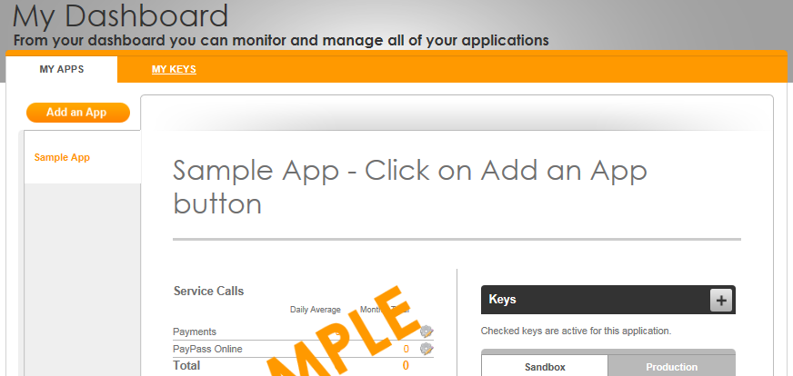
Creating an App (2)
Customer API How To
From your dashboard, choose My APPS
Click Add an App
In the displayed dialogue:
Enter an Application Name
Any alphanumeric is acceptable. The name is used by you to identify this App (i.e. this use of a particular key)
(optional) a Description
Choose the key to be used
Key alias names are available for selection
A new key may be created at this time

Slide 18
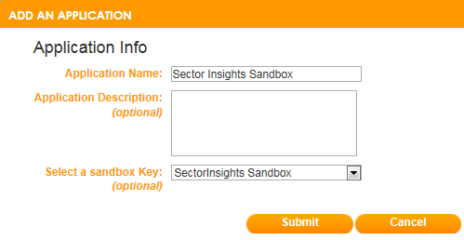
Creating an App (3)
Customer API How To
Choose the key to be used
Key alias names are available for selection
A new key may be created at this time
Click Submit
Your dashboard is redisplayed

Slide 19
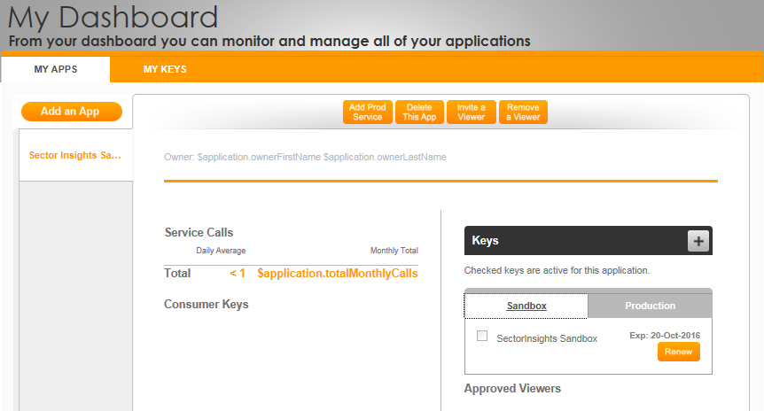
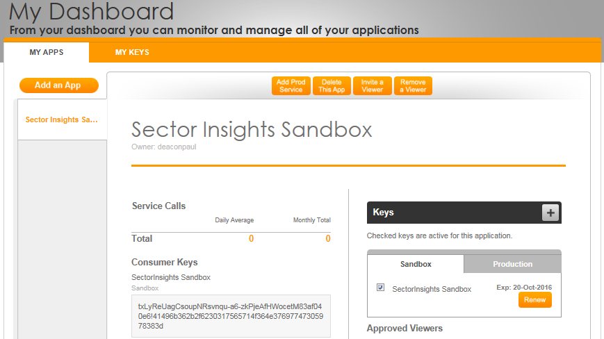
Creating an App (4)
Customer API How To
Notice, the key you associated with the App is shown, BUT it is not yet ACTIVE.
Click the checkbox to make the key ACTIVE – you must activate the key in order to use it.
Once activated, the display is changed. Note the display of the key.
Apps for the sandbox are automatically approved for use with the sandbox API data.

Slide 20
Use the Active Key in Your Code
Customer API How To
Now that you have an active sandbox key, associated with an App, that is approved by MasterCard …
You need to develop a system/application that you can use to access the API that uses the active key.
You also need to use the appropriate sandbox URL:
For SpendingPulse™: https://sandbox.api.mastercard.com/spendingpulse/v1/spulse.svc/subscription
For Sector Insights™: https://sandbox.api.mastercard.com/sectorinsights/v1/sectins.svc/parameters

Slide 21
Production API (1)
Customer API How To
To access the production API you must have a production key.
Review slides 7-14
Generate a new key (see slides 9-10)
In the “Add a Key” dialogue (see slide 11) choose “Production”

Slide 22
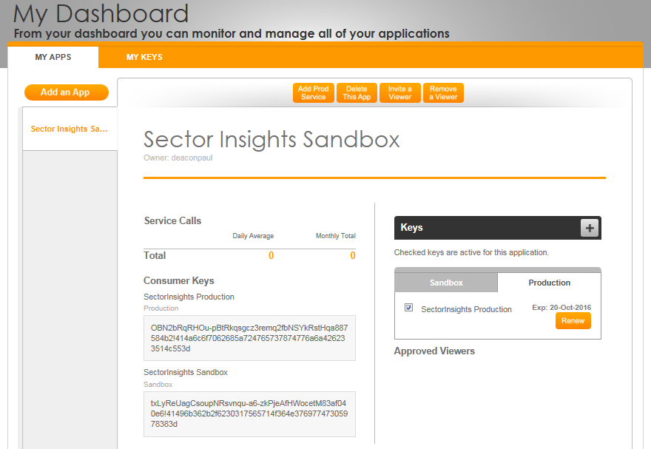
Production API (2)
Customer API How To
You may create a new App or use any existing App in order to associate the new production key with the App.
In this example, the existing App (from slides 18-19) was used.
Note: this App is still associated with the sandbox key.

Slide 23
Production API (3)
Customer API How To
You will receive an email verifying that the key is now available.
As that email states, however, there is a further step you must take in order to access production data.
Click “Add Prod Service”

Slide 24
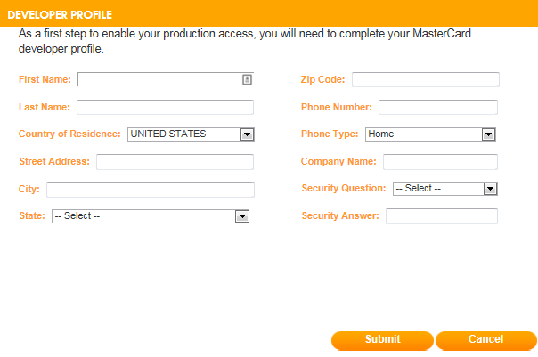
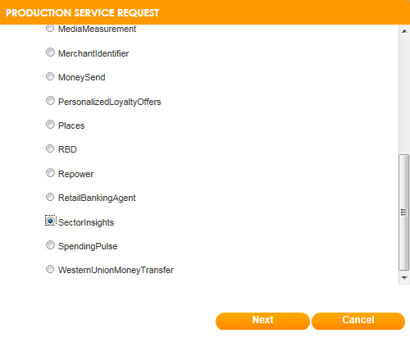
Production API (4)
Customer API How To
If you have not yet completed your profile, you will now be prompted to complete it.
Click “Submit” and the “Production Service Request” dialogue is displayed. Scroll down and choose either “Sector Insights” or “SpendingPulse”.
Click “Next”

Slide 25
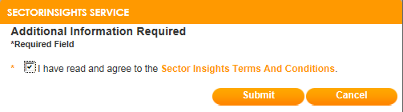
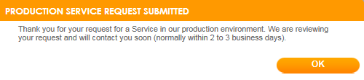
Production API (5)
Customer API How To
You are prompted to certify that you have read and agreed to the Sector Insights™ or SpendingPulse™ Terms and Conditions.
Click “Submit” and your production request is queued for review and approval by MasterCard.
The response to your request is sent to the email address you have on file in the API.

Slide 26
Administrator API How To

Slide 27
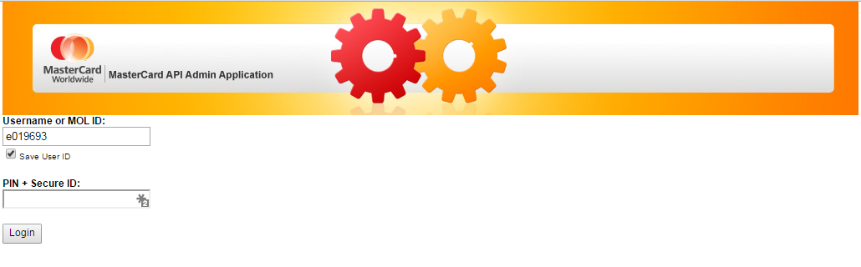
Approve/Deny Key Requests (1)
Administrator API How To
When a key request is made, an email is sent to the Service owner.
Log in to the API Admin Application. Prior to doing this, you must contact the API team and request, then be approved for, administrator access. https://mcapiadmin.mastercard.com/mcapiadmin/MCAPIAdmin.html#LoginPlace:null

Slide 28
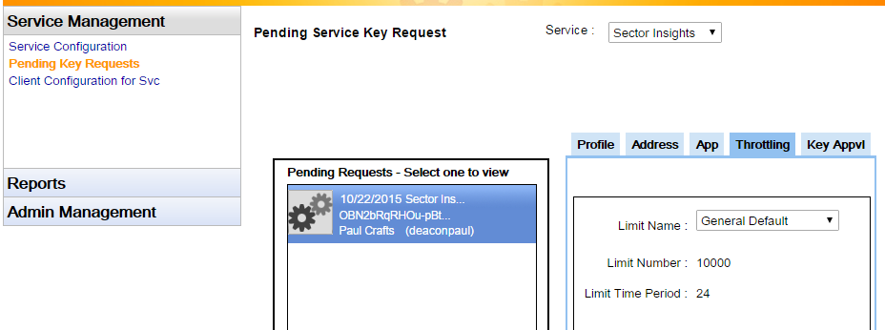
Approve/Deny Key Requests (2)
Administrator API How To
From the now displayed “Service Management” list …
Click “Pending Key Requests”
Choose “Sector Insights” or “SpendingPulse” from the Service drop-down.
If any key approval requests have been submitted they will be displayed in the “Pending Request” list.
Click through the “Profile”, “Address” and “App” tabs to insure you know whom it is that is making the request.

Slide 29
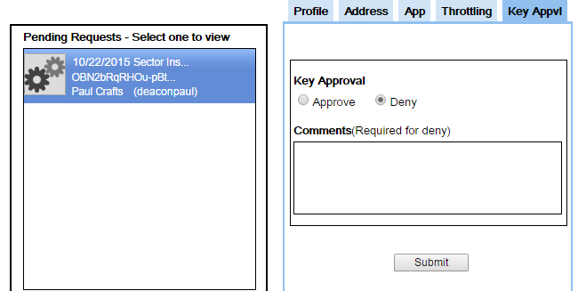
Approve/Deny Key Requests (3) – No valid Service
Administrator API How To
Check the Salesforce Order Management system to determine if a valid and approved Service is in place for the API. If need be contact the salesperson/owner of the opportunity.
If no valid and approved Service is in place:
And your investigation determines that a valid/approved Service is not forthcoming, DENY the request … a denial email is sent to the requestor.

Slide 30
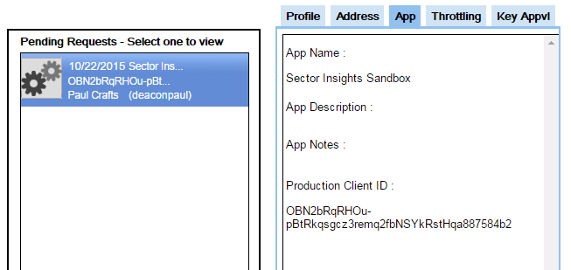
Approve/Deny Key Requests (4) – Valid Service
Administrator API How To
If a valid and approved Service is in place or your investigation determines that a valid/approved Service is forthcoming and the request should be approved …
Click the App tab and copy the Production Client ID
For Sector Insights, record the Client ID in the …/SpendingPulse/API/API Subscription files/Sector insights Keys.xlsx file.
Without this file, the only way to know who has been granted prod access is to have an API developer run a data pull against the AP database.

Slide 31
Approve/Deny Key Requests (5) – Valid Service
Administrator API How To
For SpendingPulse, record the Client ID in the …/SpendingPulse/API/API Subscription files/SpendingPulse API Subscription Data.xlsx file.
The “SpendingPulse API Subscription” tab of this file must be saved as a .csv file and uploaded, using the API MDE Upload facility – the same facility used to upload the Sector Insights and SpendingPulse data to the API.
To upload the subscription data, use the REL5 – DW-P-SPENDINGPULSE REPLACE SUBSCRIPTION bulk type.
Once the subscription data has been successfully uploaded, Approve the request … an approval email is sent to the requestor.

Slide 32
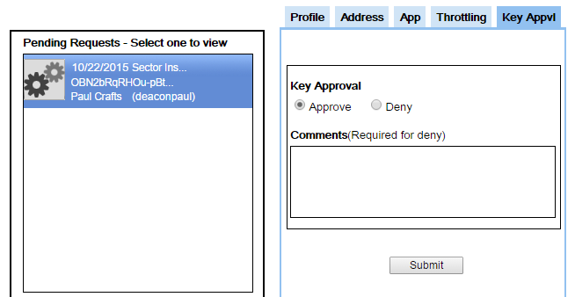
Approve/Deny Key Requests (6) – No valid Service
Administrator API How To
Once the subscription data has been successfully uploaded, Approve the request … an approval email is sent to the requestor.
To grant production access to SpendingPulse it takes BOTH:
Uploaded subscription data for the Client ID
Approved Key

Slide 33
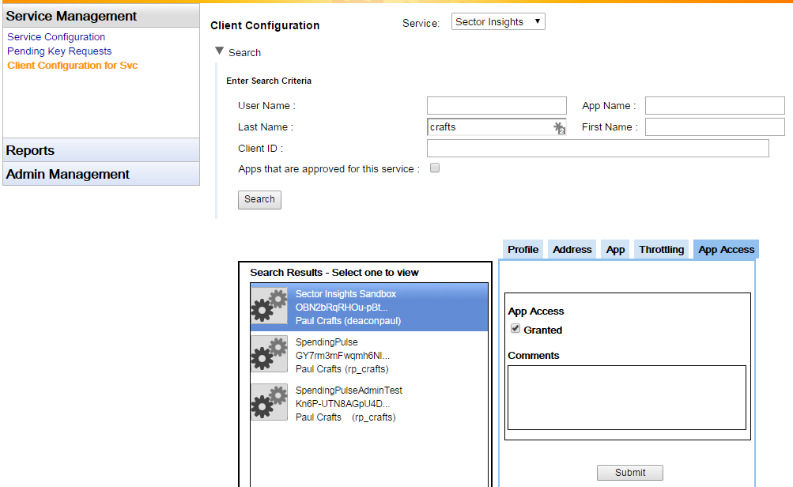
How to Deactivate/Deny a Previously Approved Key (1)
Administrator API How To
Log in to the API Admin Application (slide 27)
From the now displayed “Service Management” list …
Click “Client Configuration for Svc”
Choose “Sector Insights” or “SpendingPulse” from the Service drop-down.
Use the “Search” fields to locate the owner/App of the key you want to revoke.
Select the key within the “Search Results” list.

Slide 34
How to Deactivate/Deny a Previously Approved Key (2)
Administrator API How To
Uncheck the “Granted” box
Click “Submit”
Remove the Client ID from either the subscription data file (one or both) as needed. If for SpendingPulse, upload the subscription file (see slide 31). Sector insights Keys.xlsx or SpendingPulse API Subscription Data.xlsx

Slide 35
SpendingPulse Data Upload – DON’T Forget
Administrator API How To
For BOTH Weekly Gasoline data and US Exec data:
Must FIRST delete last report’s data – then upload new data
If not, both sets of data are exposed in the API.

